Slide 1


Vehicle & Pedestrian Detection and Classification System
Tin Ko Ko Win

Slide 2
Abstract
Artificial Intelligence is major factor in Computer Vision
Interpretation of real world to computers
Far better than traditional methods with deep learning
Detect and classify vehicles & pedestrian
Can greatly assist self-driving cars
If adequate hardware, it’ll able to apply in real-time applications

Slide 3


Introduction
Practical with huge-improvement of hardware in recent years
Computer vision can be utilized in many fields
Primary process in automotive machines
Self-driving cars will be major role people’s transportation
Implement with Singleshot Multibox Detector and use KITTI dataset for training

Slide 4

Objective
To learn about capabilities of deep learning and computer vision
To study how deep learning theories implemented in real-world applications
To get more understanding of how machine study based on training data ( how Loss function and backpropagation work )
To develop an object detection system that can work on user grade computers.
To assist in self-driving cars and robotics

Slide 5
Related Works
Due to the usefulness of this cutting-edge technology, SSD have been used by researchers in many computer vision related field. I'll describe some recent related work.

Slide 6
1. Abandoned Object Detection
Authors - Devadeep Shyam, Alex Kot and Chinmayee Athalye
Method - Used finite state machine and Single Shot MultiBox Detecctor
To detect person and some suspected type of objects which include backpack, handbag
In order to suppress any false alarm, they remove other stationary candidate objects other than the suspected stationary objects
2. SSD-MSN: An Improved Multi-Scale Object Detection Network Based on SSD
Authors - ZUGE CHEN , KEHE WU, YUANBO LI, MINJIAN WANG, AND WEI LI
Method - SSD-MSN
Proposed Area Proposal Network(APN) to get better performance on small scale image
APN used to select area proposal containing one or more object while SSD is predicting location and classification
Used PASCAL VOC and COCO dataset and found that SSD-MSL improved multi-scale object detection effectively

Slide 7
3. Ship Detection System
Authors - Yuanyuan Wang , Chao Wang, Hong Zhang, Cheng Zhang, and Qiaoyan Fu
Method - Single Shot Multibox Detector
Used both SSD-300 and SSD-512
Images acquired by Chinese Gaofen-3 satellite are used
Experimental results reveal that compared to SSD-300, SSD-512 achieves more than 0.02 in probability of ship detection, whereas 0.05 worse in false alarm.

Slide 8
Theory Background

Slide 9
Former Detection Systems
Former detection algorithm like HOG ( Histogram of Oriented Gradient ), SVM ( Support Vector Machine ), Viola-Jone Algorithms before CNN
Not grade in both speed and accuracy
Sliding window approach with CNN
Better but too much computational expensive

Slide 10
Modern Object Detection Systems
In 2013, Regions with CNN ( R-CNN ) and become game changer
Got acceptable accuracy but speed is a matter
YOLO in 2nd quarter of 2015
Even earliest YOLO can perform real time because of much better fps
When faster R-CNN , become best accuracy until now and acceptable speed 7 fps
Feasible for research but not for real-time
Then Singleshot Multibox Detector came into play
Not best in anywhere and best trade-off
With enough hardware, self-driving cars will able to interact with real-world.

Slide 11
Singleshot Multibox Detector ( SSD )
Singleshot - SSD is a single-shot detector. It has no delegated region proposal network and predicts the boundary boxes and the classes directly from feature maps in one single pass. That is why it much faster than RCNN family.
MultiBox - This is the name of a technique for bounding box regression developed by Szegedy et al.
Detector - Because of it detects objects

Slide 12

SSD Architecture
Base Network
Extra Feature Layers or Auxiliary Layers
Prediction

Slide 13
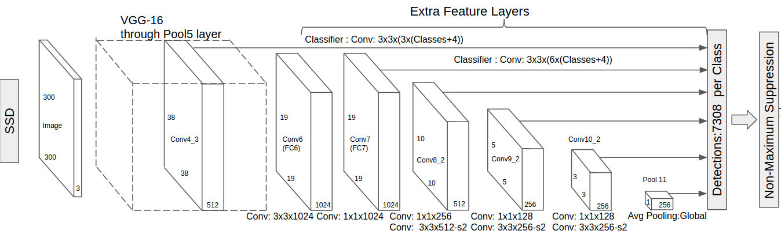
Visualization of SSD Architecture
Liu W. et al. (2016) SSD: Single Shot MultiBox Detector. In: Leibe B., Matas J., Sebe N., Welling M. (eds) Computer Vision – ECCV 2016. ECCV 2016. Lecture Notes in Computer Science, vol 9905. Springer, Cham

Slide 14
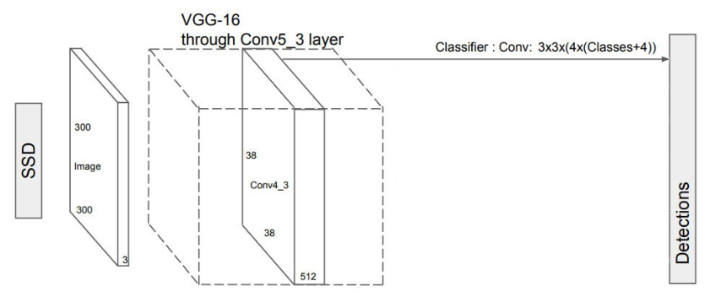
Base network
SSD use VGG-16 as base network to extract feature maps and some use more stronger networks like ResNet, Xeception, and GoogleNet to get better performance. But I'm here use original VGG-16 for the sake of simplicity, its popularity for transfer learning that helps in improving results and speed.

Slide 15
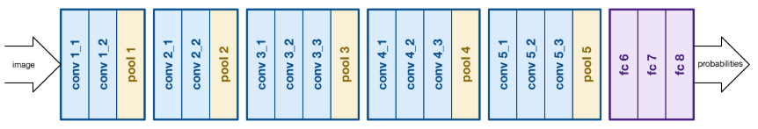
Vgg-16
VGG-16 is also known as VGGNET and it is the runner-up in ILSVRC2014 ( ImageNet Large Scale Visual Recognition Competition ). It is much similar to the former architecture AlexNet and using only 3*3 convolutions. VGG-19 is one that use more convolutions. Here is the visualization of VGGNET..

Slide 16
Extra Feature Layers or Auxiliary Layers
SSD add four extra layers for better detection in difference object size.

Slide 17
Default Boxes
An important part of SSD
Each cell in feature map include 4 or 6 default boxes and contain total of 8732 default boxes
The Chosen default boxes are selected with predefined IOU ( Intersection Over Union ). The standard IOU is 0.5 and some straiten model use 0.7.
The intention of SSD is to get default boxes with offsets of objects

Slide 18
Prediction
The prediction is the crucial part of SSD. SSD predict in every cell of feature maps by matching default boxes with ground true boxes.

Slide 19

Choosing default boxes
As SSD relies heavily on default boxed. It is critical to choose the right default boxes. The Scale of default boxes calculate based on the position of feature map. Con4_3 is responsible for detecting smallest objects so the scale is set to 0.2 ( sometime 0.1 ) the rightmost conv is for large objects and the scale is set to 0.9. In addition to scale we also need aspect ratio that determine basic shape of class. In real life, not all object are in equal aspect ratio ( People , car etc. ). These aspect ratios get from clustering of classes

Slide 20
Choosing Default Boxes
At each position on a feature map, there will be various aspect ratios. All feature maps will have priors with ratios 1:1, 2:1, 1:2. The intermediate feature maps of conv7, conv8_2, and conv9_2 will also have priors with ratios 3:1, 1:3. Moreover, all feature maps will have one extra prior with an aspect ratio of 1:1 and at a scale that is the geometric mean of the scales of the current and subsequent feature map.

Slide 21
Feature Map | Dimensions of Image | Scale | Aspect Ratio | Number of Default boxes per position | Total Number of default boxes
Conv 4_3 | 38 * 38 | 0.1 | 1:1,2:1,1:2,extra box | 4 | 5776
Conv 7 | 19 * 19 | 0.2 | 1:1,2:1,1:2,3:1,1:3,extra box | 6 | 2166
Conv 8_2 | 10 * 10 | 0.375 | 1:1,2:1,1:2,3:1,1:3,extra box | 6 | 600
Conv 9_2 | 5 * 5 | 0.5 | 1:1,2:1,1:2,3:1,1:3,extra box | 6 | 150
Conv 10_2 | 3 *3 | 0.725 | 1:1,2:1,1:2,extra box | 4 | 36
Conv 11_2 | 1 * 1 | 0.9 | 1:1,2:1,1:2,extra box | 4 | 4
Total |  |  |  |  | 8732 default boxes
Choosing Default Boxes
Sagar Vinodababu,N.D, a PyTorch Tutorial to Object Detection, https://github.com/sgrvinod/a-PyTorch-Tutorial-to-Object-Detection

Slide 22
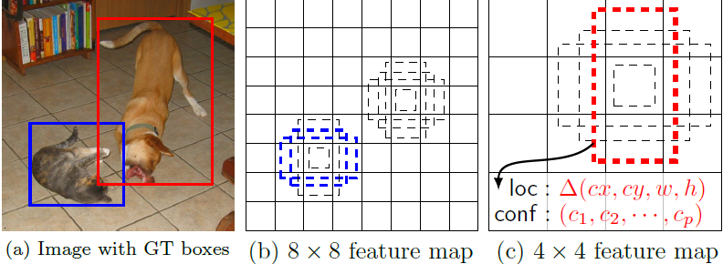
Visualization of Default Boxes
Liu W. et al. (2016) SSD: Single Shot MultiBox Detector. In: Leibe B., Matas J., Sebe N., Welling M. (eds) Computer Vision – ECCV 2016. ECCV 2016. Lecture Notes in Computer Science, vol 9905. Springer, Cham

Slide 23
Non-Max Suppression
One of the problem with single shot detector ( SSD, YOLO ) is overlapping multiple boxes to a single object. The method that can tackle this problem is called Non-Max Suppression. NMS simply suppress all the overlapping boxes except the box with maximum IOU.

Slide 24
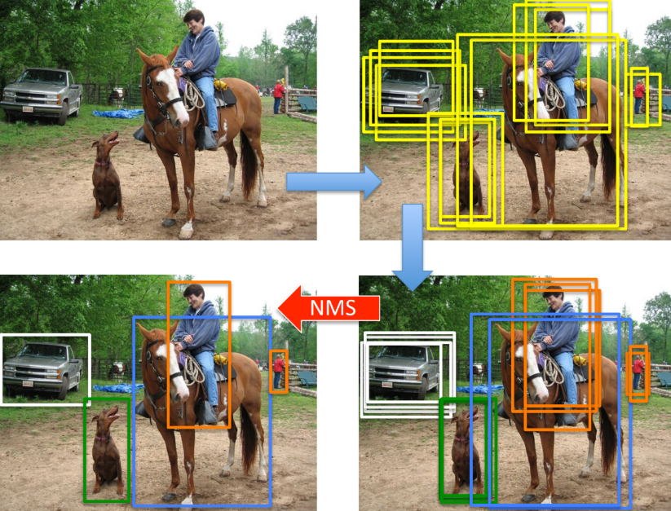
Non-Max Suppressions
Aman Damia, May 1 2019, Real-time object detection: Understanding SSD, https://medium.com/inveterate-learner/real-time-object-detection-part-1-understanding-ssd-65797a5e675b

Slide 25
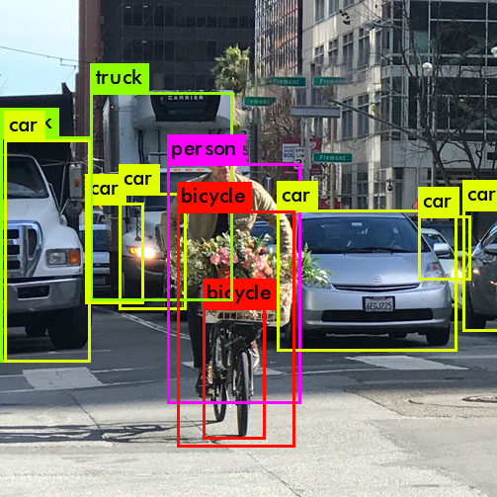
Proposed system
The system will detect and localized objects in every frame of input video file and classify with labels on bounding boxes.

Slide 26
Chuan Li, January 06, 2019, Tips for implementing SSD Object Detection (with TensorFlow code), https://lambdalabs.com/blog/how-to-implement-ssd-object-detection-in-tensorflow/
All the data got from tested with four of Nvidia 1080Ti graphic card and on SSD512 and took over 42.5 hours and much lower fps ( nearly half ) than SSD300 although got 2.5% better accuracy. While my graphic card is just single Nvidia 1070 and so I think it is a better trade off to choose SSD300.
Network | SSD300 | SSD512
Training Speed ( images/sec ) | 145 | 65
Total training time ( 100 epochs ) | 23.5 hours | 42.5 hours
SSD512 Vs SSD300

Slide 27
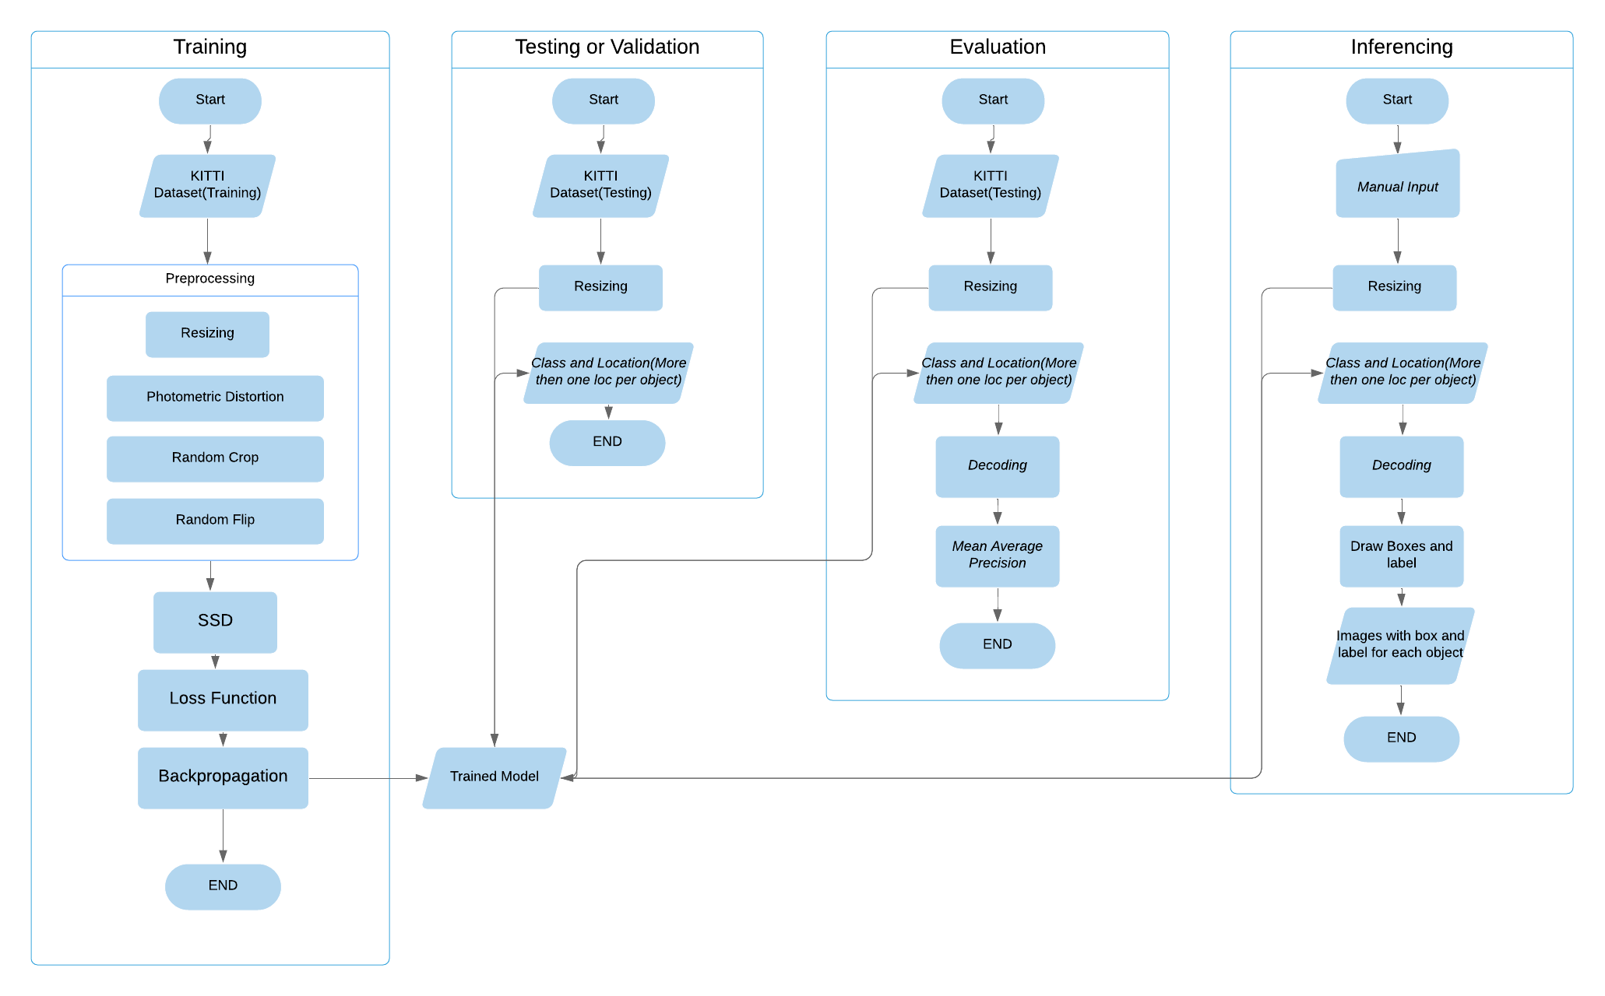
System Flow

Slide 28

Data Argumentation
Data argumentation is a good technique to get better model and avoid overfitting especially in small dataset. Argumentation is actually flipping , resizing and color distortion randomly. This will accumulate more images and the model get better learned.

Slide 29
Loss Function
In SSD Loss function is called Multibox Loss and it combine with two loss function Confident Loss and Localization Loss.
Confident Loss determine how confident it is to have an object in every single prediction.
Localization loss is how mismatch the predicted bounding boxes with the ground true boxes

Slide 30

Hard-Negative mining
We found that we got much more predictions than the ground true boxes. Instead of getting rid of all negative predictions, we keep some of the top loss negative predictions and learn form theses. This lead to better and more stable training

Slide 31
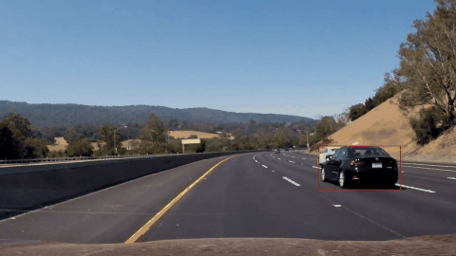
Final Result
My model will yield output with bounding boxes that match with the detected objects together with class label on each.
Sample Output gif
Eddie Forson, Nov 18 2017, Understanding SSD MultiBox — Real-Time Object Detection In Deep Learning, https://towardsdatascience.com/understanding-ssd-multibox-real-time-object-detection-in-deep-learning-495ef744fab

Slide 32
Conclusion
SSD is the efficient object detection method.
The system can be utilized in various computer vision projects.
It is worth for further researches because of its advantages over competitors.

Slide 33
Thank You

